Slide 1

Optical Properties of Materials
EPFL MSE-482
A lecture given by Dr. A. Marchioro and Prof. F. A. Nüesch
Assistants: Viktor Vorobev and Mischa Flór

Slide 2
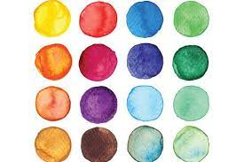
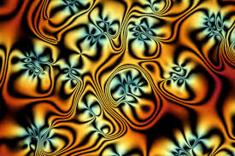
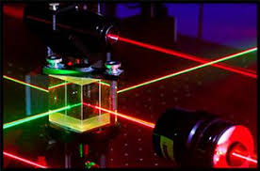
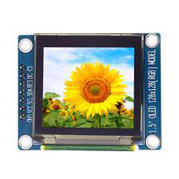
Overview of the lecture
General Introduction to the lecture
Interaction of light with matter
1.1 Maxwell equations, optical constants, polarization, interference
1.2 Fresnel equations, reflection, refraction, absorbing media
1.3 Classical dispersion theory, dielectrics and metals
1.4 Plasmons
1.5 Fundamental description of absorption and emission
Optical properties of glasses
2.1 Historical perspectives
2.2 Physical properties of glasses
2.3 Optical glasses
2.4 Optical fibers
3. Liquid Crystals
3.1 Physical properties of liquid crystals
3.2 Molecular structure and phase of liquid crystals
3.3 LCD displays
4. Experimental methods
4.1 Absorption spectroscopy
4.2 Fluorescence spectroscopy
4.3 Diffuse reflection
4.4 Ellipsometry
5. Inorganic semiconductors
5.1 Absorption and photoluminescence in crystalline inorganic semiconductors and in amorphous inorganic semiconductors
5.2 Applications: Light-receiving devices: Solar cells, photodiodes; Light-emitting devices: LEDs, lasers
5.3 Advanced optical experimental methods to characterise inorganic semiconductors: Time-correlated single photon counting, electroabsoprtion, transient absorption
6. Quantum Dots
6.1 Optical properties of quantum wells
6.2 Optical properties of quantum dots
6.3 Tuning the optical properties of quantum dots
7. Organic semiconductors
7.1 Introduction
7.2 Absorption, emission and molecular orbitals
7.3 Electronic structure in organic semiconductors
7.4 Molecular exciton theory
7.5 Organic light-emitting diodes (OLED)
7.6 Organic photovoltaic devices (OPV)

Slide 3
Exercise session: From 15:15h to 16h on Tuesdays
Lecture: From 16:15h to 18h on Tuesdays
Final exam (written)
5.5 points/6
Solving and presenting one session of exercises during the semester (during the exercise session)
0.25 points/6
During the semester
Solving 5-min quiz (3 questions) at the beginning of each exercise session
0.25 points/6

Slide 4
1. Interaction of light with matter
One of the pertinent questions to begin with is to ask ourselves what light is.
Since Aristoteles, Euclid, Democritus or Theophrastus the theory of light made lots of back and forth. Today, however, we are in the possession of all the wisdom necessary to tell us more precisely what light is and how it behaves. Those theories may be very complex and therefore we help out sometimes with simpler concepts to describe how light behaves.
Some of the most intriguing questions that were debated are:
The nature of light being particles or waves
The need or the absence of a medium allowing light to travel
The color of light and the immense spectrum of «invisible» light
The interaction of light with matter
This amazing breadth of knowledge can not be treated in depth in this lecture. Rather, we take an engineering approach to be able to discuss and predict how light would behave under specific conditions when interacting with materials.
A few stimulating examples will be given as a brief introduction.

Slide 5
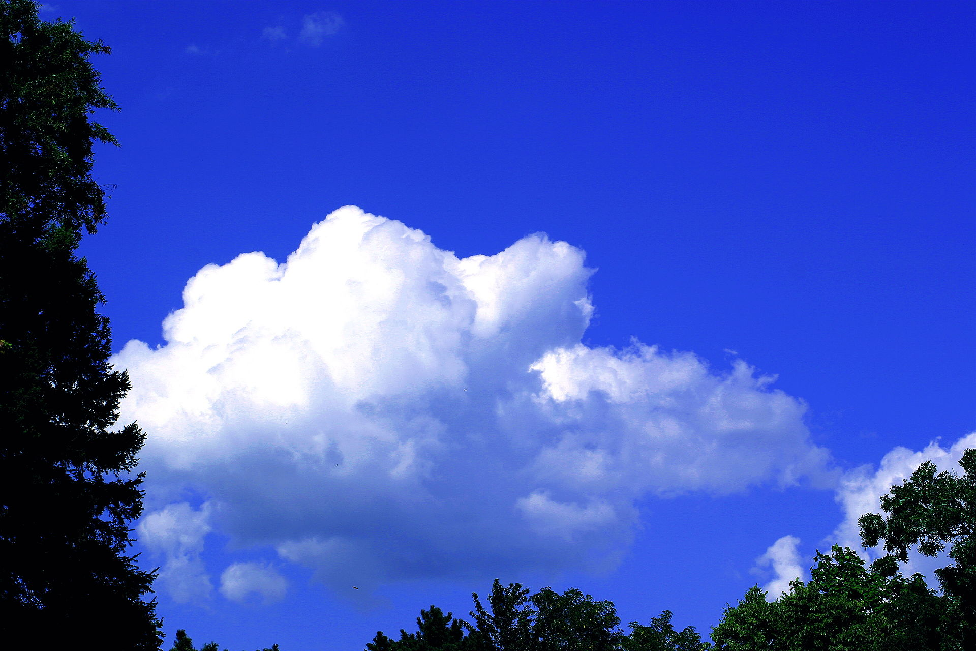
The color of the blue sky
Why is the sky blue knowing that the sun that illuminates it is white as the clouds.
Note: if we look at condensed sky (i.e. liquid nitrogen) we do not observe a blueish hue.

Slide 6
Etched glasses
Glass is transparent. The etched surfaces appear whitish

Slide 7
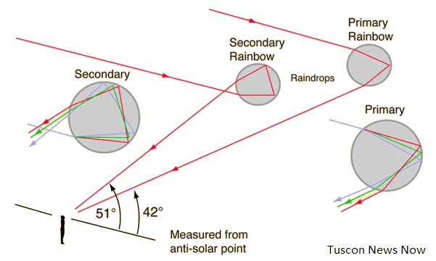
Rainbow
Four to seven colors can be seen. In some cases a much fainter second rainbow is observed at the same time.

Slide 8
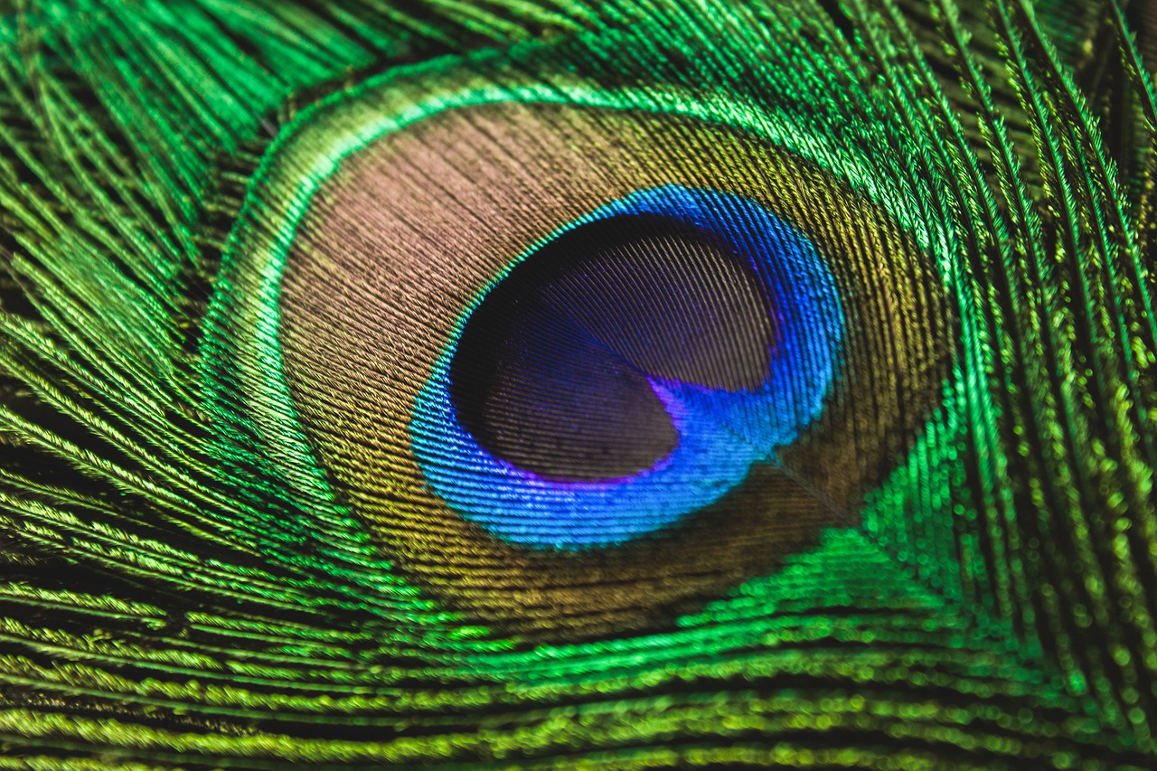
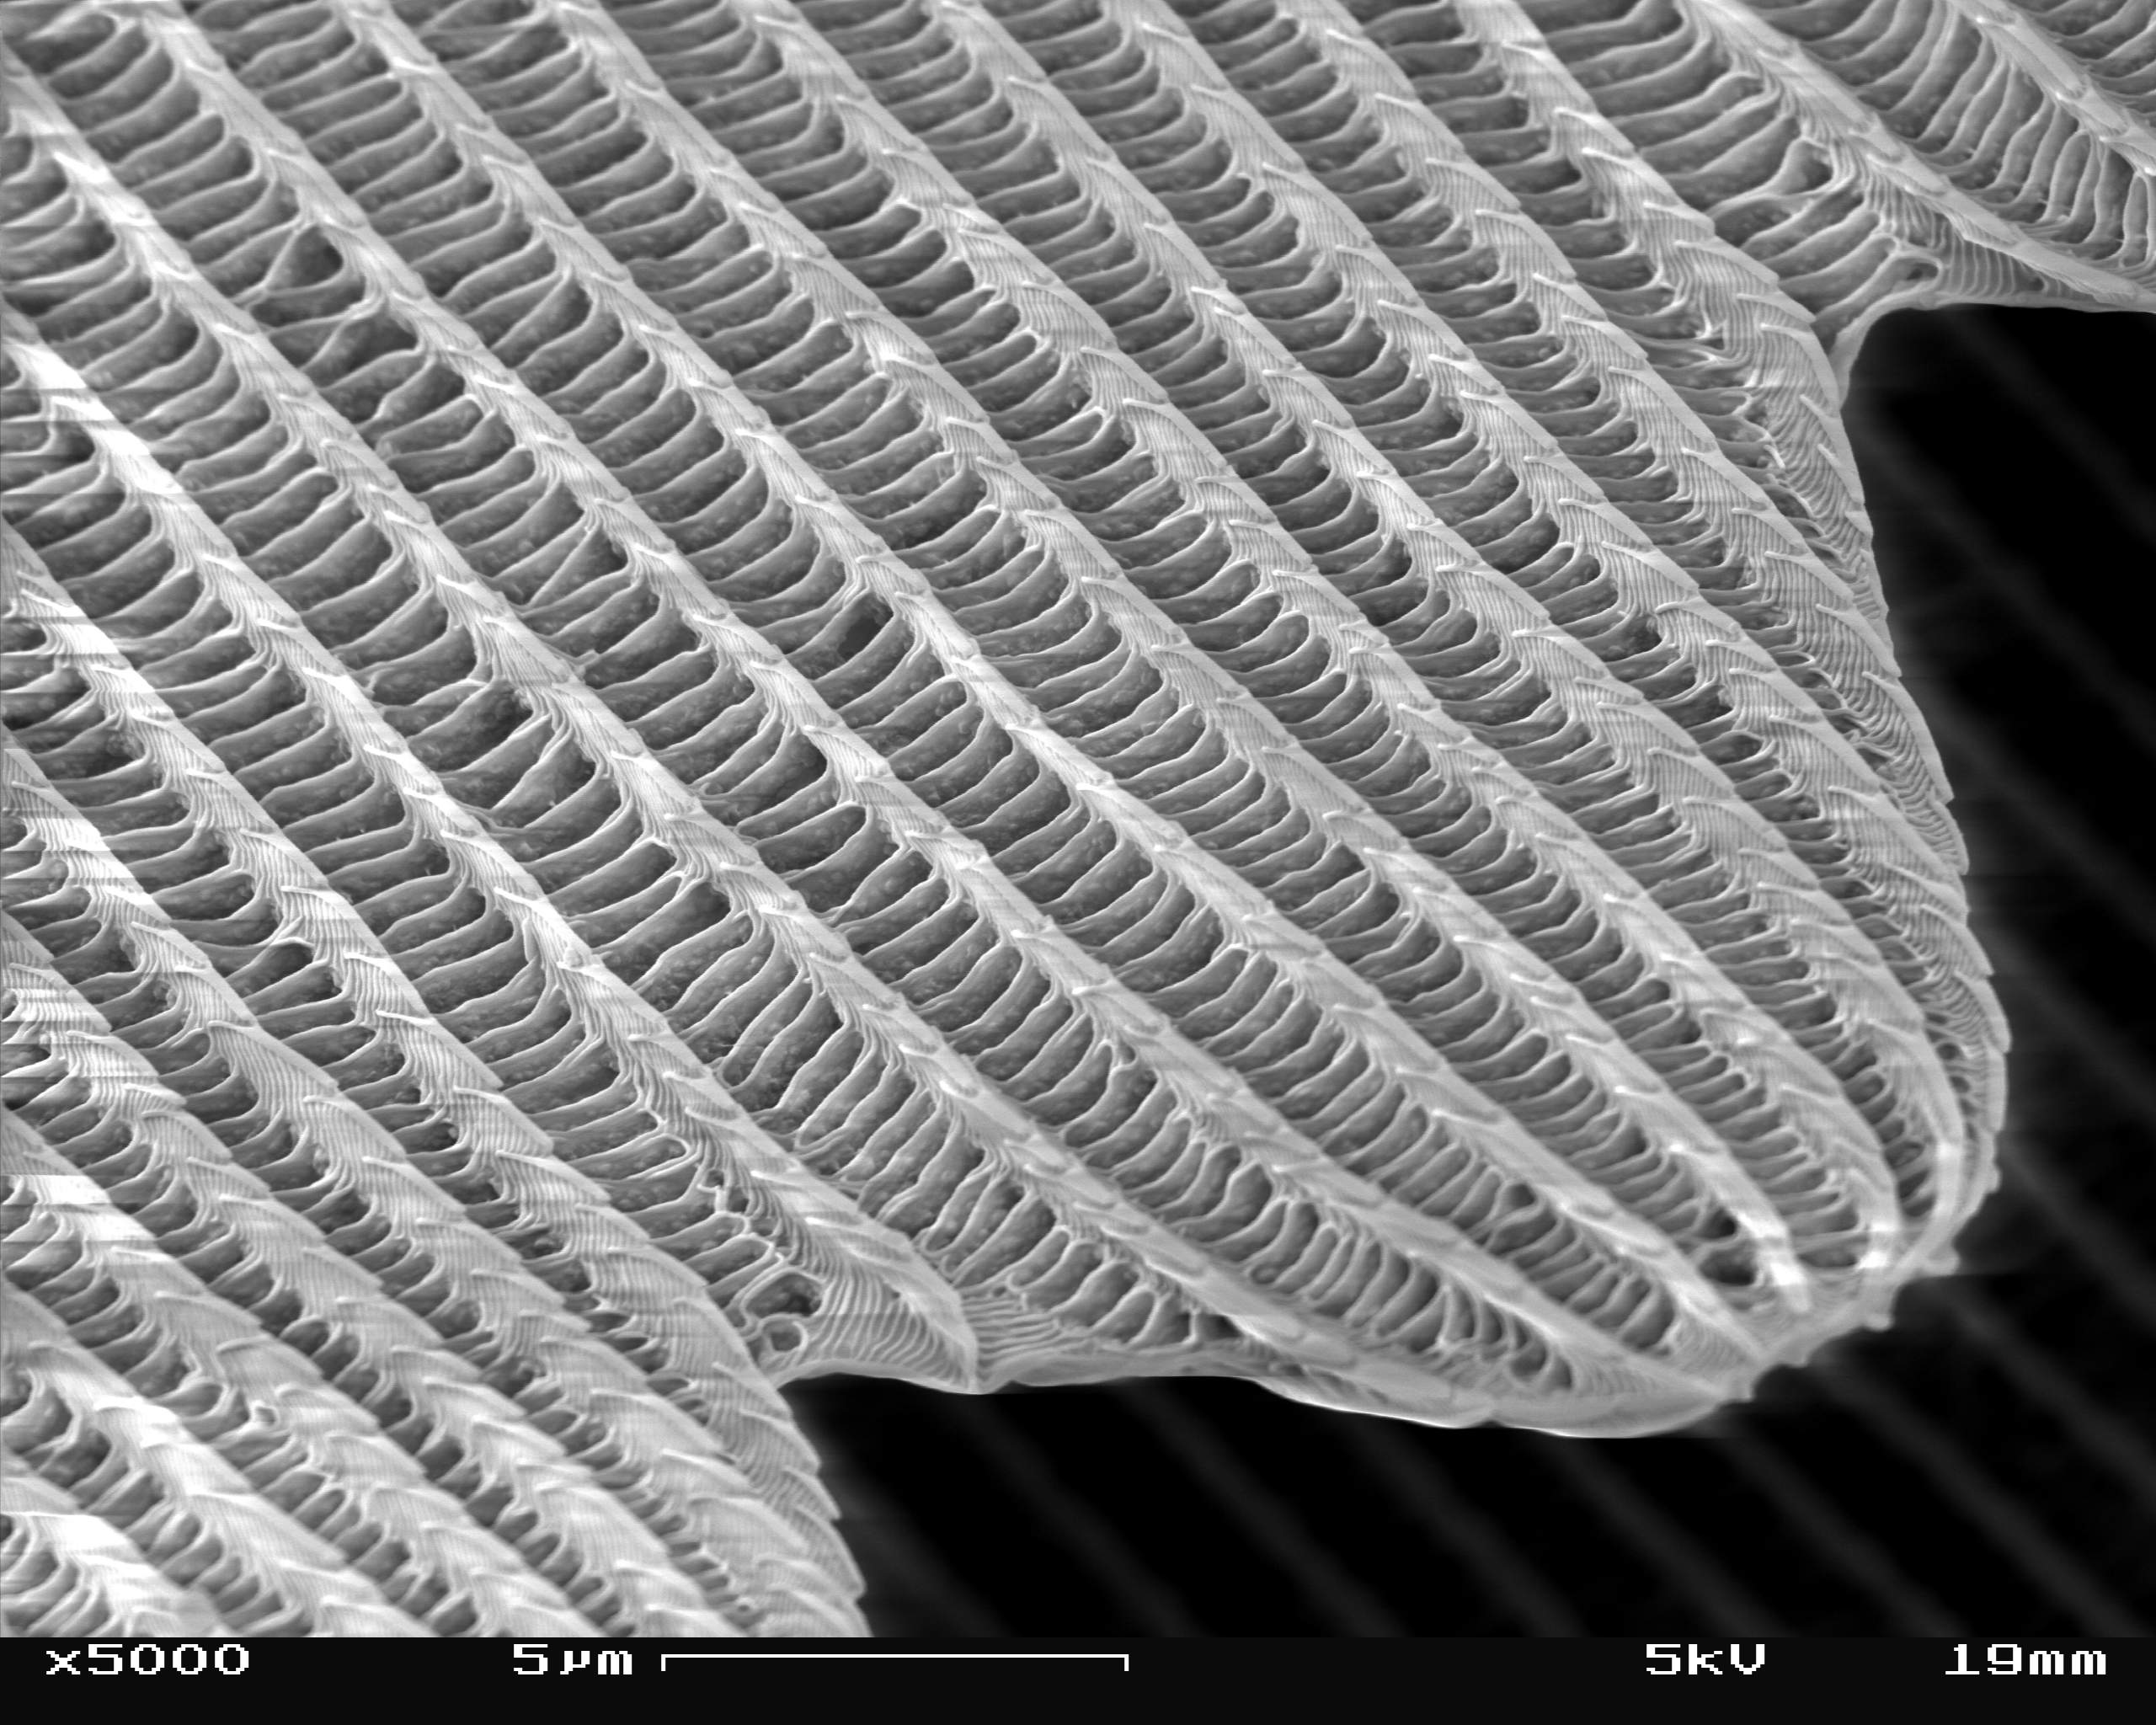
Peacock feather
Glittery colors appear on the feathers of a peacock under sun light.

Slide 9
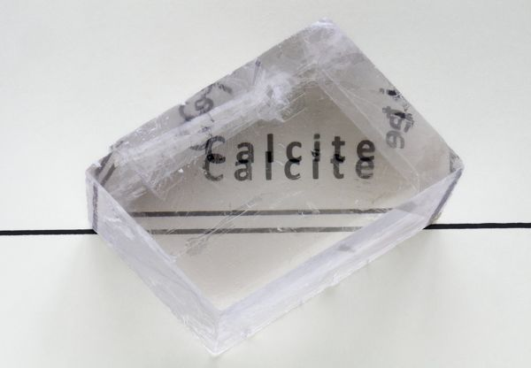
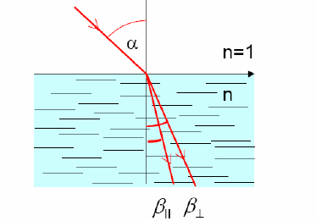
Birefringence
Two images are seen through a birefringent crystal.

Slide 10
Stress induced birefringence

Slide 11
Antireflective coatings

Slide 12
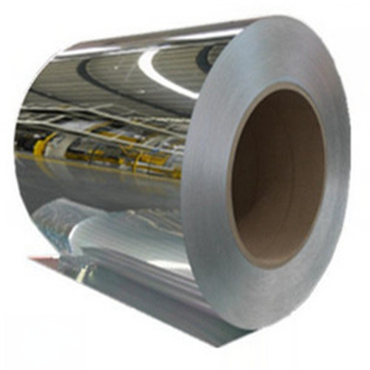
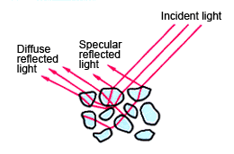
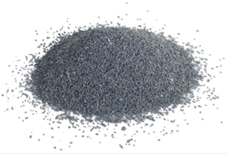
Metals
Metals have mirror-like reflection for smooth surfaces, but are dark grey powders when grinded.
aluminum

Slide 13
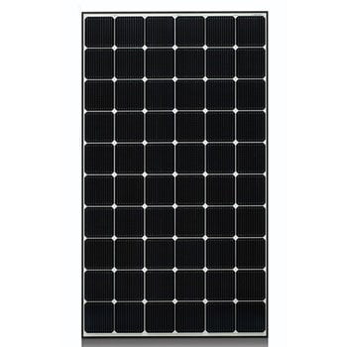
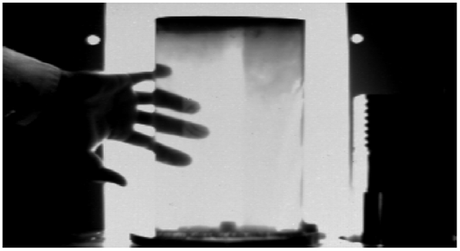
Semiconductors
Silicon wafers absorb a large range of the solar photons and are used in PV. Silicon ingots can be inspected using NIR light.

Slide 14
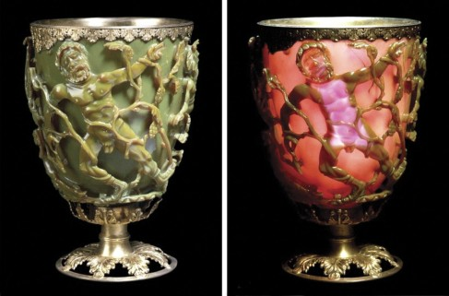
Lycurgus Cup: A piece of ancient roman nanotechnology (this glass contains 50 nm Ag and Au particles)

Slide 15
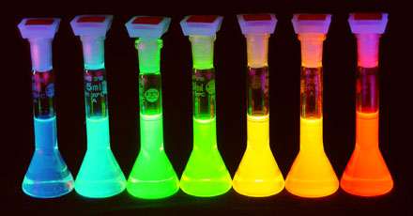
Quantum dots: tuning emission color with particle size
2 nm to 7 nm CdSe particles

Slide 16
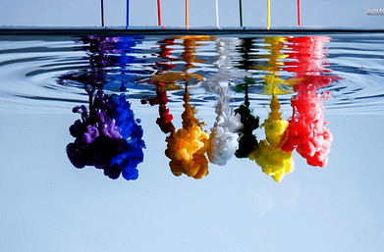
Synthetic inks
Among the strongest light absorbers

Slide 17
The world of dyes
Tohamy et al., Ecotoxicology and Environmental Safety 231 (2022) 113160

Slide 18
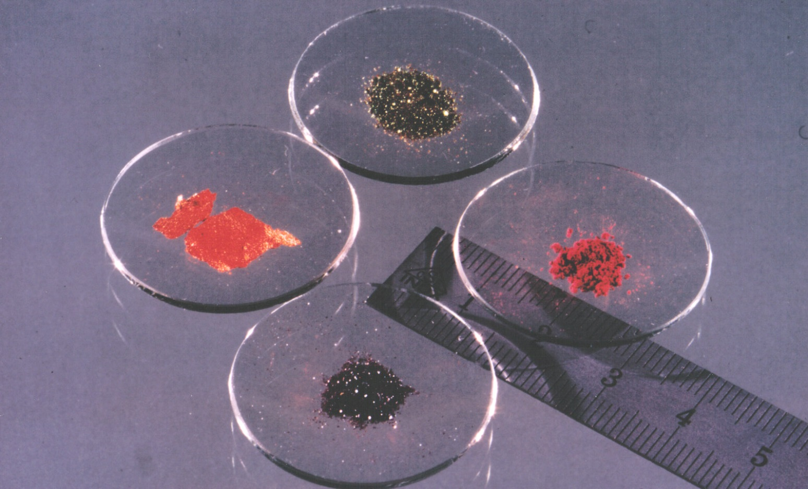
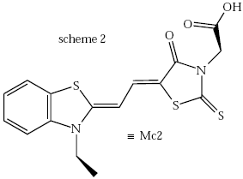
Reflection and absorption in organic crystals
It is all the same dye!

Slide 19
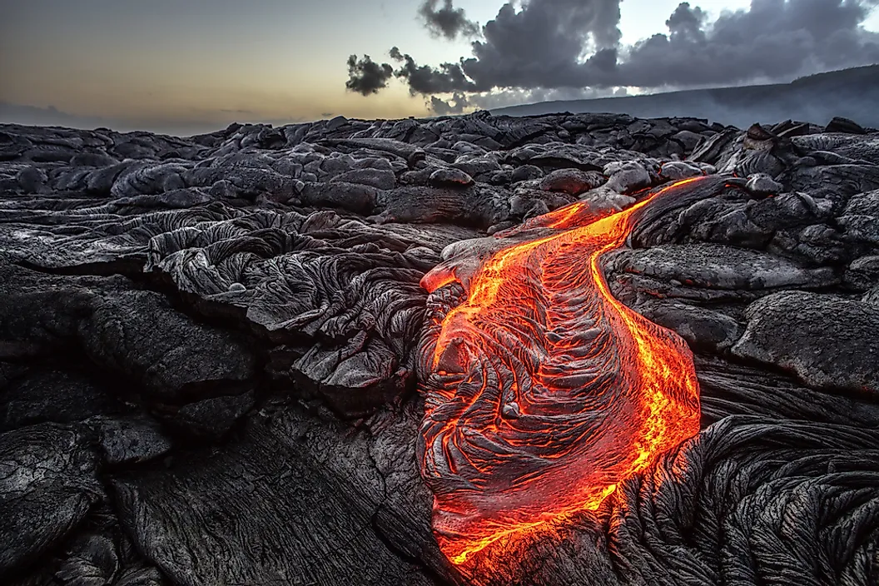
Light emission by hot lava

